Slide 1
Raising Children in more than one Language
ANU Centre for European Studies
and
ACT Bilingual Education Alliance
Australian National University
Saturday 14 August 2021

Slide 2
Acknowledgement of country
We acknowledge the Traditional Owners and Custodians of the land on which we meet today.
Ngunnawal and Ngambri people have used language in this region for over 10,000 years and it is important to reflect on their historic and ongoing contribution to the ACT and surrounds.
We wish to pay our respects to Traditional elders, past and emerging leaders, and any other Aboriginal and / or Torres Strait Islander people who are present today.

Slide 3
the oldest research centre in Australia focused on the study of Europe and the European Union
interdisciplinary research, education and outreach hub
strong links to government and industry
convenes and supports various outreach activities addressed to a broader public, follow @ https://www.facebook.com/anuces/

Slide 4
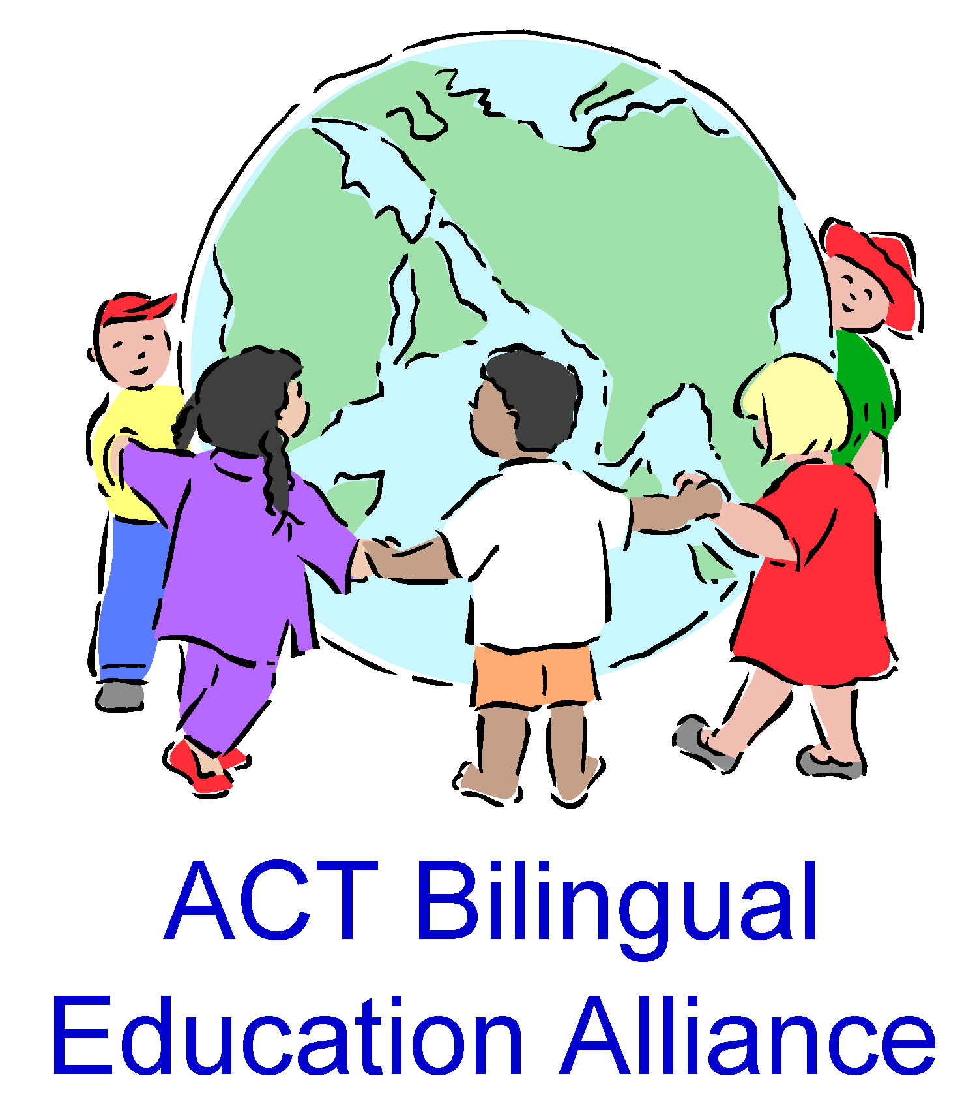
ACT Bilingual Education Alliance (ACTBEA)
About us
Local non-profit community group
Aims to promote and support bilingualism in the Canberra region
Members (membership is free)
Young families
Academics and language experts
Language teachers, tutors and students

Slide 5
ACTBEA activities
ACTBEA promotes and supports bilingualism in the Canberra region by providing
information about bilingualism and its benefits
information on how and where languages can be learned and developed in the Canberra region
practical advice on how to raise children in more than one language
tailored talks for teachers, parents and other groups interested in bilingualism and/or language learning and teaching

Slide 6
Outline of Seminar/Discussion
Overview of the issues: benefits, approaches and challenges
Initial presentations from panel members
Comments and Questions
Summing up and closing
Informal networking

Slide 7
Benefits of having bilingual skills
General cognitive and academic benefits
Metalinguistic awareness
Wider world view and enhanced intercultural skills
Family and community relationships
Identity development and social and emotional well-being
Future possibilities for employment, study and travel

Slide 8
Approaches and Strategies
One parent One language (OPAL)
Community language in the home
Family language plans and contracts

Slide 9
Challenges
Community attitudes and expectations
Social and peer pressure
Time and dedication

Slide 10
The panel
Vesna and Dunja
Tobias
Shuyu
Karo
Shun and Junta
Kasia and Tom

Slide 11
Over to you
Questions and comments

Slide 12
Thanks
ACTBEA thanks the following for making this event possible:
ANU Centre for European Studies
Canberra Multicultural Community Forum Inc
ACT Government 2021/22 Participation (Multicultural) Grant
Our ACTBEA organising group
Panel members and
All our participants on Zoom

Slide 13
PLEASE KEEP IN TOUCH
Facebook: @actbea
Email: canberrabilingual@gmail.com
Website: https://actbilingual.weebly.com/

Slide 14
References
Bouko et al, 2020. How to raise a bilingual child: Practical guide for parents with ready-to-use activities. PEaCH Project
National Literacy Trust (UK), 2017. Understanding Bilingualism in the Early Years
Wilson Sonia, 2019 ‘Family language policy through the eyes of bilingual children: the case of French heritage speakers in the UK’ Journal of Multilingual and Multicultural Development 41(3):1-19
Wilson Sonia, 2021, ‘To mix or not to mix Parental attitudes towards translanguaging and language management choices’. International Journal of Bilingualism 25 (1) 58-76
Links to the first two references and other resources can be found on the ACTBEA website: https://actbilingual.weebly.com/

